Slide 1

Visualization in 2d

Slide 2
Group members :-
Shubhanshu Mohan
Worked on pie chart
Fatima Yasmin
Worked on line graph
Harsh Mavi
Worked on histogram
3903- Shubhanshu Mohan
3907- Fatima Yasmin
3955- Harsh Mavi
3960- Vandana
Vandana
Worked on bar graph
& multi bar graph

Slide 3

DATA VISUALIZATION IN PYTHON

Slide 4
What is data visualization ?
With so much information being collected through data analysis in the business world today, we must have a way to paint a picture of that data so we can interpret it. Data visualization gives us a clear idea of what the information means by giving it visual context through maps or graphs. This makes the data more natural for the human mind to comprehend and therefore makes it easier to identify trends, patterns, and outliers within large data sets.

Slide 5
Why data visualization is important ?
Data visualization can help by delivering data in the most efficient way possible
Data visualization takes the raw data, models it, and delivers the data so that conclusions can be reached.

Slide 6

Benefits of data visualization
Correlations in
relationships.
Trends Over Time.
Frequency.
Examining the
market.
Risk and Reward.
Reacting to the
market.

Slide 7

Why python for data visualization ?
Though there are lots of tools available for Data Visualization, Python has few best libraries that make Python Visualization easy for any dataset. These libraries make Python Visualization affordable for large and small datasets.

Slide 8
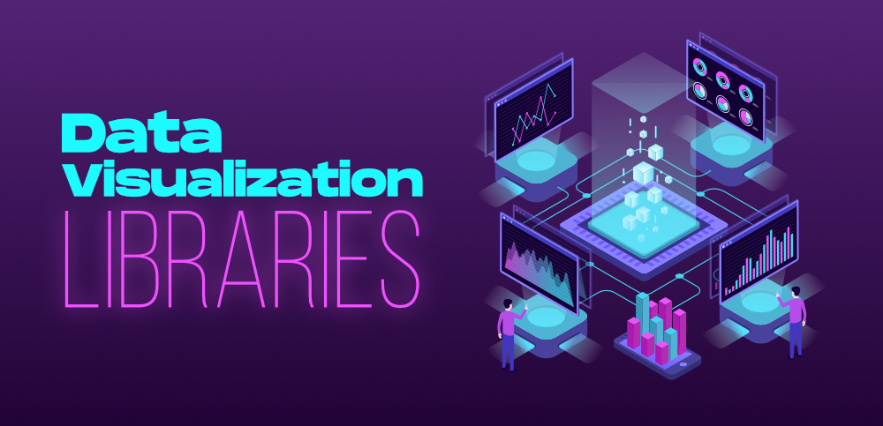
Python

Slide 9
What is matplotlib ?
Matplotlib is a cross-platform, data visualization and graphical plotting library for Python and its numerical extension NumPy. As such, it offers a viable open source alternative to MATLAB.

Slide 10
Matplotlib and NumPy
NumPy is a package for scientific computing. NumPy is a required dependency for matplotlib, which uses NumPy functions for numerical data and multi-dimensional arrays.

Slide 11
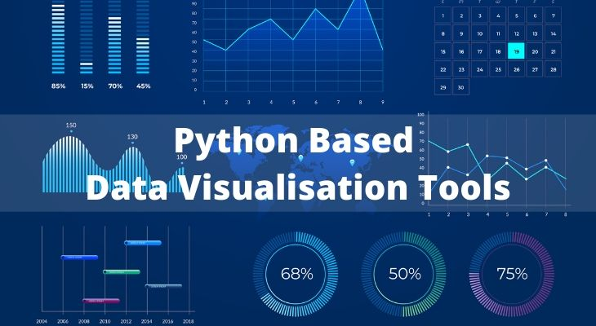

Slide 12
Types of data visualization :-
Pie chart
Line graph
Histogram
Bar graph
Multiple bar graph

Slide 13
Some common functions for graphs in python
Legend ( ) :- legend function one can add legends to a plot where
multiple data ranges have been plotted ,but before that the
data ranges must have their level argument defined in plot ( )
or bar ( ) function
Labels :- Label is used to specify the container box where we can place
the text or images.
Show :- function to show the graph
Title :- to give an appropriate title to the graph.

Slide 14
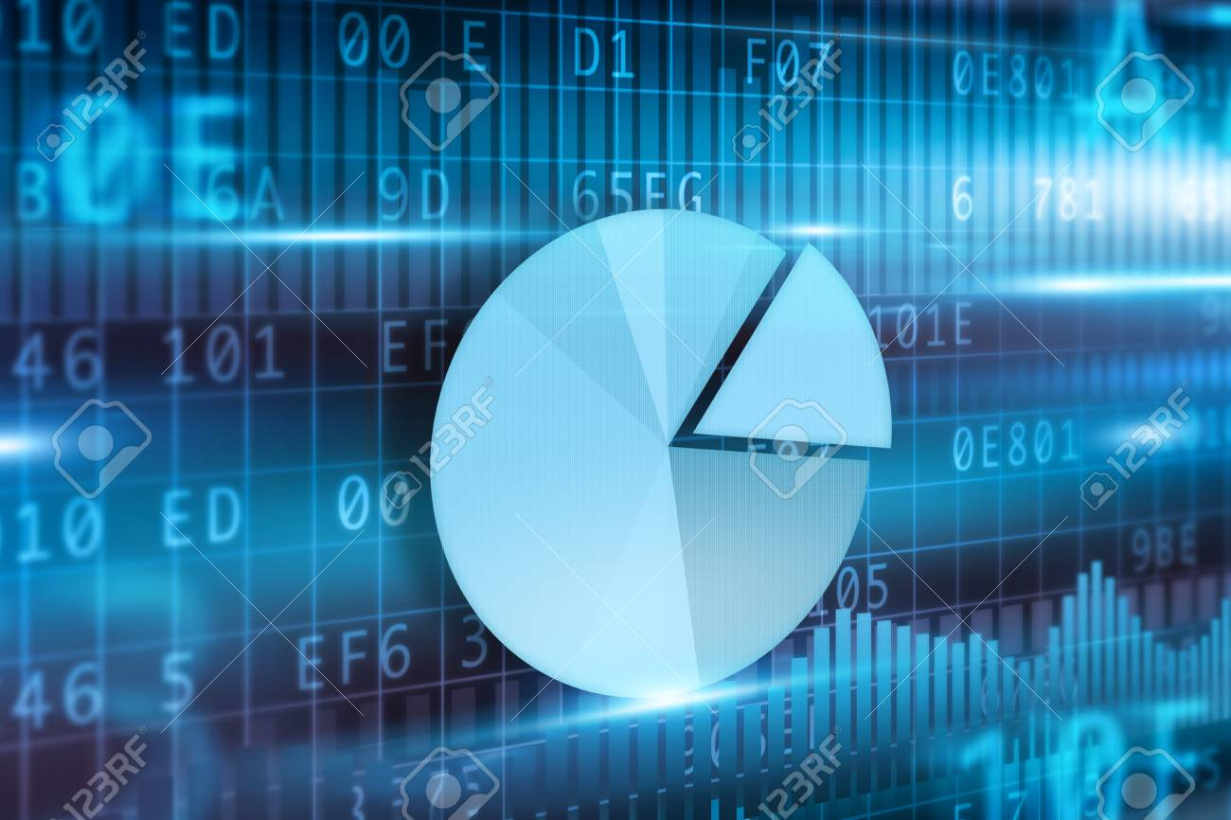
Pie Chart
Pie Chart is a type of plot which is used to represent the proportion of each category in categorical data. The whole pie is divided into slices which are equal to the number of categories.

Slide 15
Functions in python for Pie Chart
pie ( ) :- pie function use to create pie chart.
startangle :- the starting angle of pie chart.
autopct :- autopct enables you to display the percent
value using Python string formatting.
shadow :- to show the shadow of pie chart.
explode :- The explode() function is used to transform
each element of a list-like to a row,
replicating the index values.

Slide 16
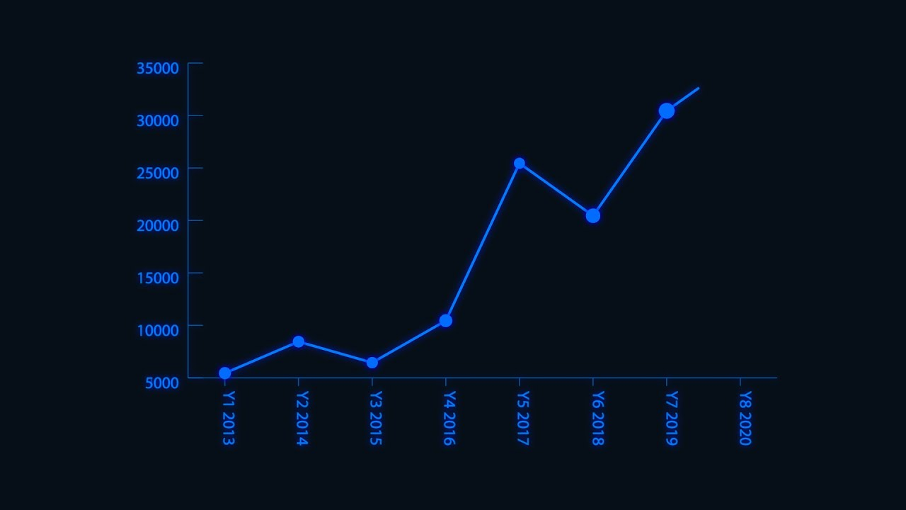
Line Graph
A line graph is a type of chart used to show information that changes over time. We plot line graphs using several points connected by straight lines. We also call it a line chart. The line graph comprises of two axes known as ‘x’ axis and ‘y’ axis.

Slide 17
Functions in python for Line Graph
plot() :- plot function is use to create line graph.
xlabel :- naming the x-axis.
ylabel :- naming the y-axis.
linestyle :- to give an appropriate style to the line.
marker :- Marker is a special way of handling
markers in Matplotlib graphs it’s a kind of
symbol at the joining point of two lines.
xlim & ylim :- set the range of x-axis and y-axis.

Slide 18
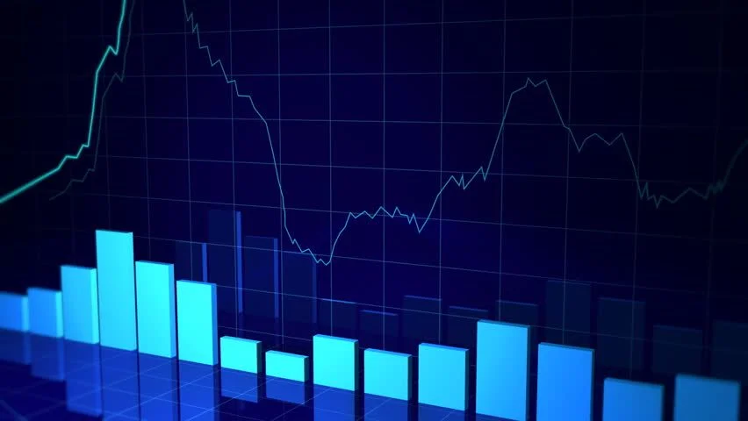
Histogram
A histogram is a graphical representation of a grouped frequency distribution with continuous classes. It is an area diagram and can be defined as a set of rectangles with bases along with the intervals between class boundaries and with areas proportional to frequencies in the corresponding classes.

Slide 19
Functions in python for histogram
hist() :- hist function use to create histogram.
subplot :- subplots() function in the matplotlib library, helps in creating
multiple layouts of subplots.
np.random() :- The np.random( ) function from NumPy library is
used to create a range of random values.
figsize() :- specifies size of the bar.

Slide 20

Bar Graph
Bar Graph or Bar Chart is used to represent categorical data with vertical or horizontal bars. It is a general plot that allows you to aggregate the categorical data based on some function, by default the mean.

Slide 21
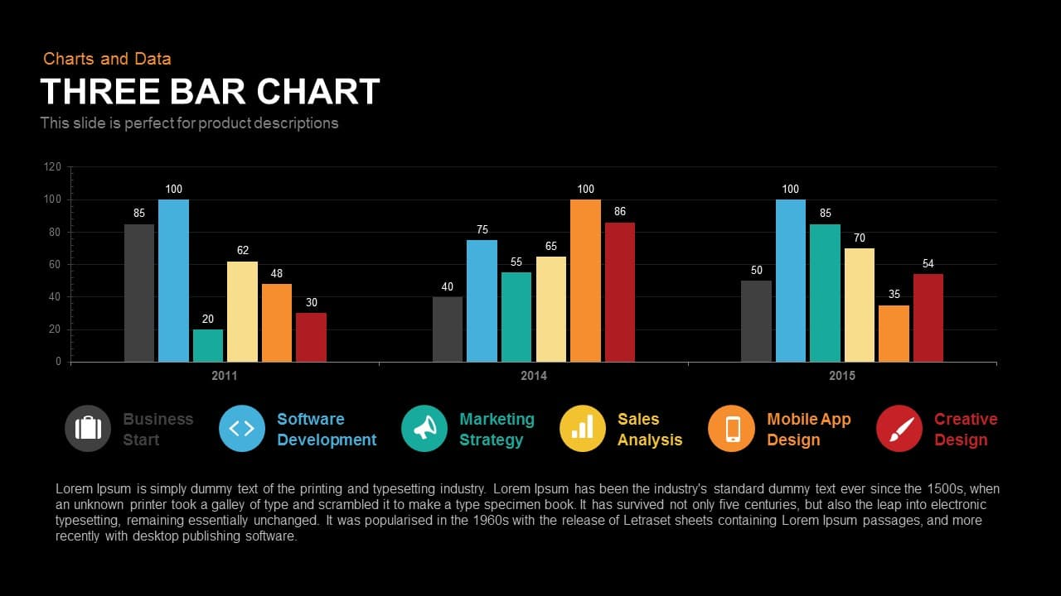
Multi Bar Graph
A multiple bar graph is a graph that has multiple bars for each category . A multiple bar graph compares as many sets of data you want. The process for creating a multiple bar graph is just like creating any other bar graph, only you will have more colors to represent different sets of data.

Slide 22
Functions in python for Bar Graph
Bar( ) :- this function is use to create a bar graph.
Barh :- this function is use to create horizontal bar
graph.
xticks :- the tick marks for the x-axis value can be
defined using xticks.
yticks :- the tick marks for the y-axis value can be
defined using yticks.
arrange :-The np.arange( ) function from NumPy library is
used to create a range of values.

Slide 23

Conclusion

Slide 24
We need data visualization because the human brain is not well equipped to devour so much raw, unorganized information and turn it into something usable and understandable. We need graphs and charts to communicate data findings so that we can identify patterns and trends to gain insight and make better decisions faster.
At analytics, we understand the importance of data visualization and what it means to our clients. We provide them with user-friendly and beautiful visualization features and tools to depict their data in a clear and meaningful way. We’re here to ensure our clients have everything they need to make quick and informed decisions based on sound data that is easy to interpret.

Slide 25

References
https://www.geeksforgeeks.org
Sumita Arora python book
YouTube videos

